Slide 1
DISEASE MODEL
BY LASYA NANDAGIRI, KARTHIKEYAN RASU

Slide 2
INTRODUCTION
The Disease Management System is a comprehensive platform that enables healthcare professionals to efficiently manage patient data, track disease information, create and implement treatment protocols, and administer diagnostic tests across different.
With its robust features and user-friendly interface, the system streamlines the process of disease management and helps healthcare providers deliver high-quality care to their patients.

Slide 3
BUSINESS PROBLEM
"Enhancing disease management for healthcare providers by offering a comprehensive system that facilitates efficient tracking, diagnosis, and treatment of diseases, ultimately aiming to improve patient outcomes and streamline research and data analysis processes."

Slide 4
TABLES ( DISEASE MANAGEMENT )
DISEASE_TYPE
DISEASE
LOCATION
RACE
PERSON
TREATMENT_PLAN
HOSPITAL
HEALTH_CARE PROVIDER
DIAGNOSTIC_TEST
INSURANCE
HOSPITAL_PERSON

Slide 5
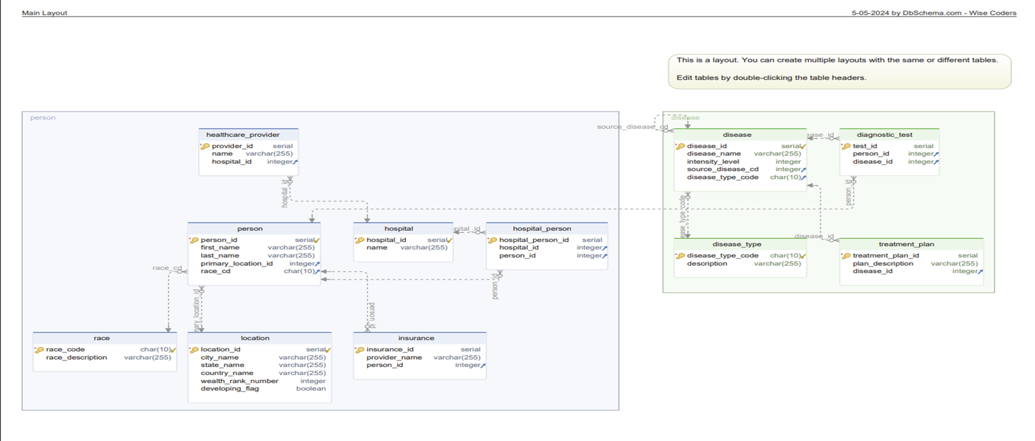
ER DIAGRAM – TRANSACTIONAL MODEL – DISEASEMANAGEMENT

Slide 6
DATA DICTIONARY

Slide 7
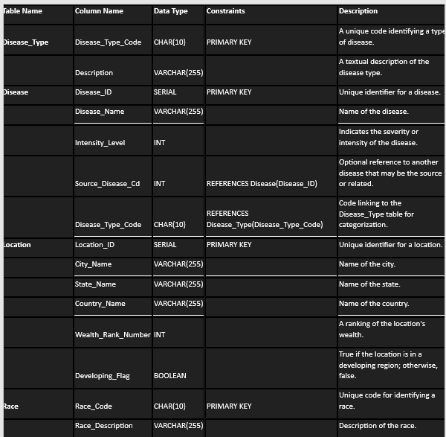

Slide 8
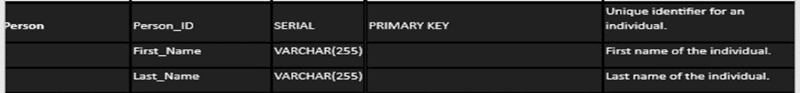
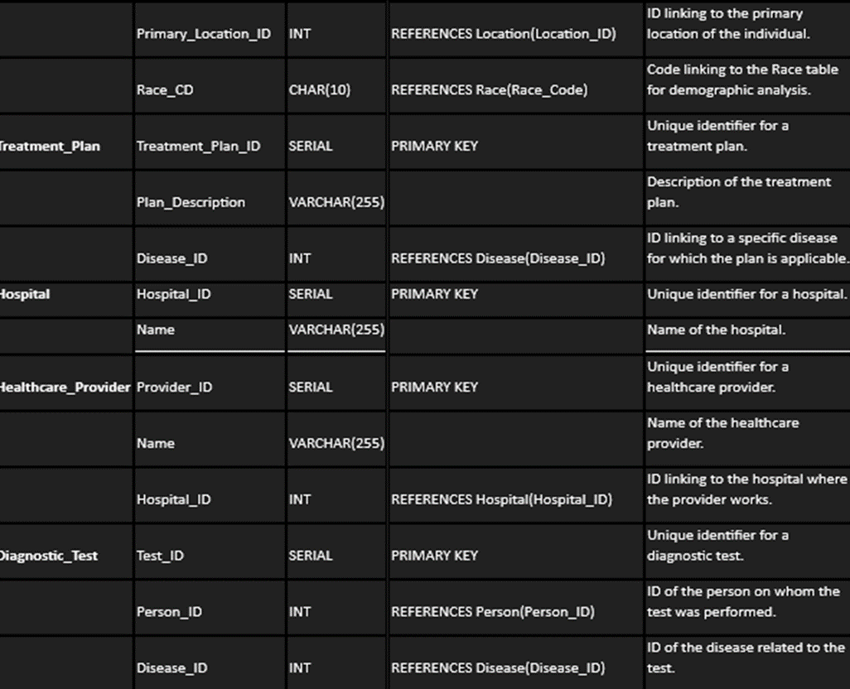

Slide 9
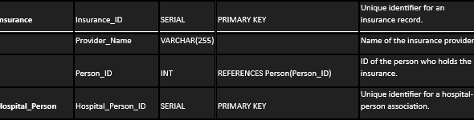


Slide 10
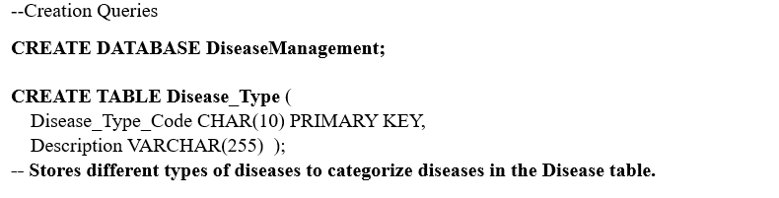
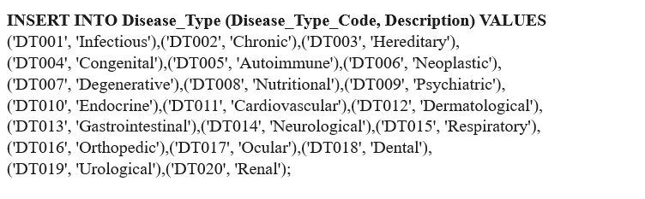
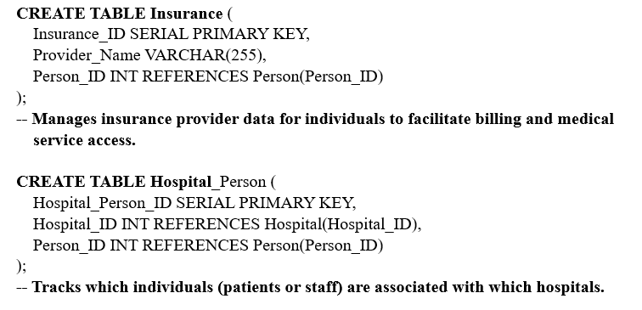
DDL COMMANDS

Slide 11
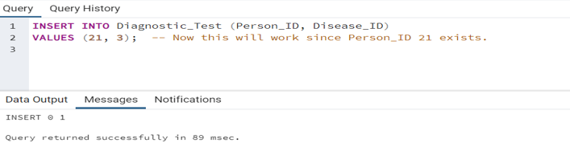
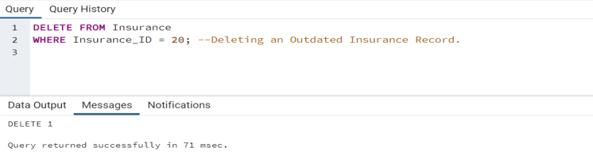
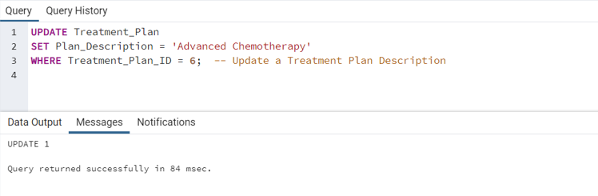
DML COMMANDS

Slide 12
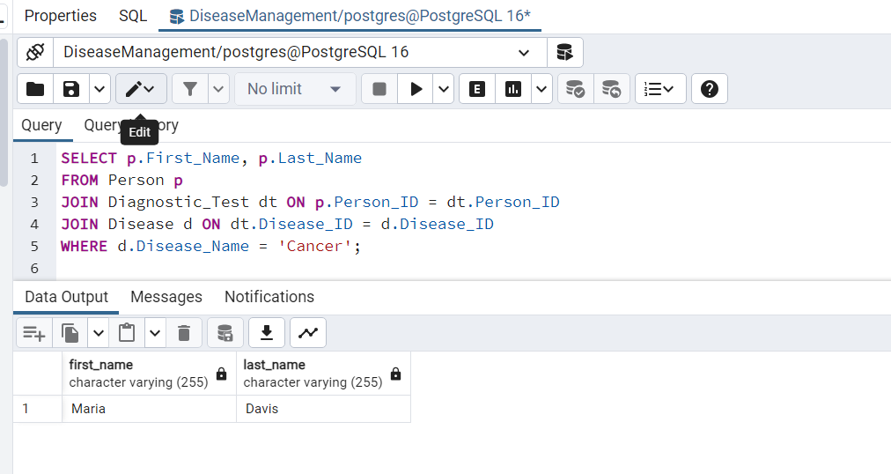
OPERATIONAL QUERIES
1)Query to Retrieve Patients with a Specific Disease:

Slide 13
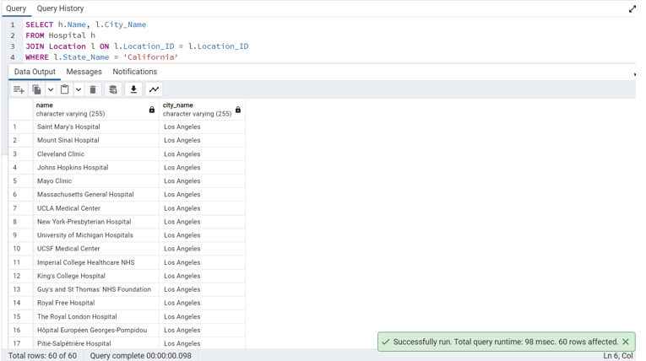
OPERATIONAL QUERIES
2) Find Hospitals in a Specific Location:

Slide 14
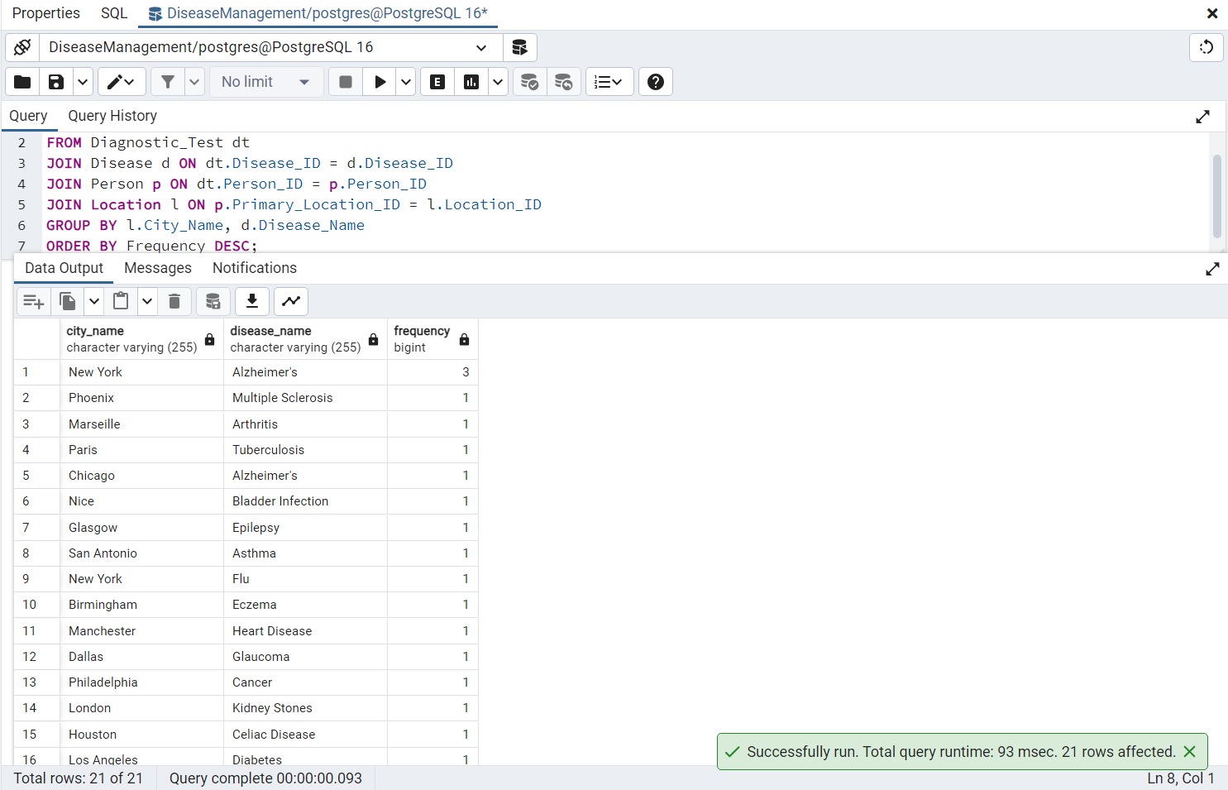
REPORTS
1) Report on disease frequency by location:

Slide 15
DIMESNIONAL MODEL
Identifying the business processes:
Disease Diagnosis: Captures each instance of disease diagnosis.
Treatment Administration: Records details of treatments provided to patients, tracking the administration and outcomes of these treatments.

Slide 16
DIMESNIONAL MODEL
Defining Fact tables:
1) FactDiagnosis:
Purpose: Tracks each diagnosis event, providing insights into when, where and how diseases are diagnosed, linked to time, patient, disease type, and diagnostic methods used.
2) FactTreatment:
Purpose: Captures detailed records on treatments administered including the outcomes, and the providers involved, crucial for effectiveness and quality of care analysis.

Slide 17
DIMESNIONAL MODEL
Dimension Tables
1) Date Dimension (DimDate):
Purpose: This table provides temporal context for all events in the data warehouse, facilitating time-series analysis. This dimension helps analyze data across different timeframes.
2) Patient Dimension (DimPatient):
Purpose: Tracks demographic information about patients, supporting detailed patient-level analysis. Provides a comprehensive view of the patient demographics.
3) Disease Dimension (DimDisease):
Purpose: Facilitates analysis by disease type and category, crucial for epidemiological studies. Categorizes diseases which can be useful for specialized analytics.

Slide 18
DIMESNIONAL MODEL
4) Diagnostic Test Dimension (DimDiagnosticTest):
Purpose: Provides details on diagnostic tests, aiding in the evaluation of test utilization and effectiveness. Describes the tests used in diagnostics, important for analysis of test utilization and efficacy.
5) Treatment Dimension (DimTreatment):
Purpose: Enables analysis of treatment patterns and their outcomes. Detailed records of treatment protocols provide insights into treatment patterns and outcomes.
6) Healthcare Provider Dimension (DimHealthcareProvider):
Purpose: Stores information about healthcare providers, important for performance and resource allocation analysis. Helps in analyzing performance and specialization areas of providers.

Slide 19
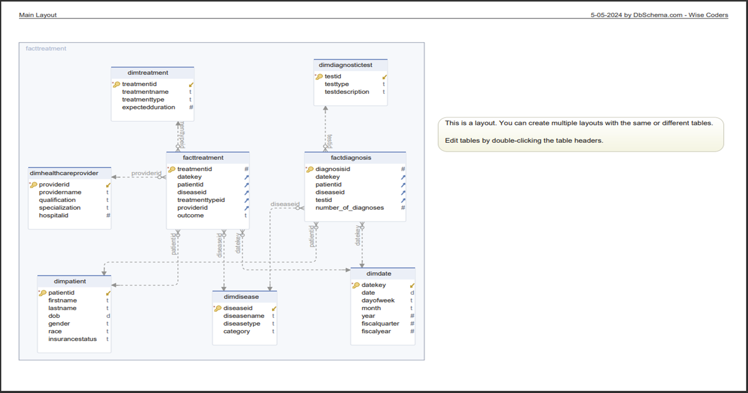
DIMENSIONAL MODEL

Slide 20
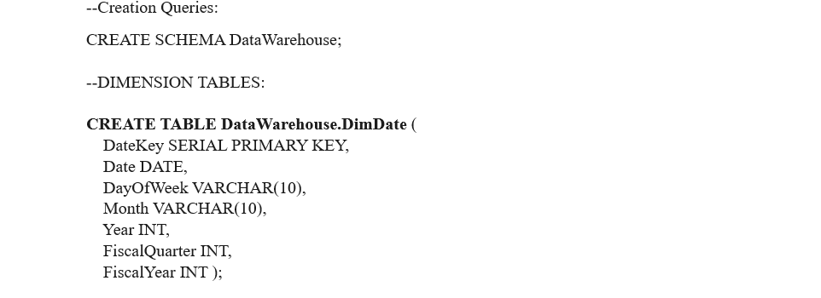
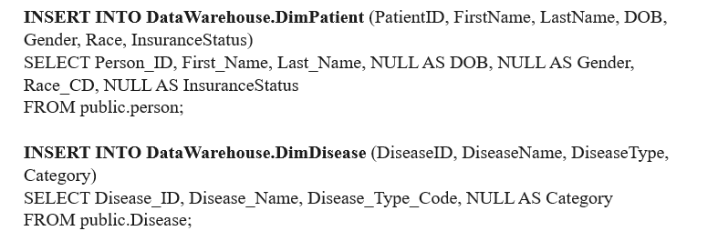
Setting up data warehouse – ETL Process

Slide 21
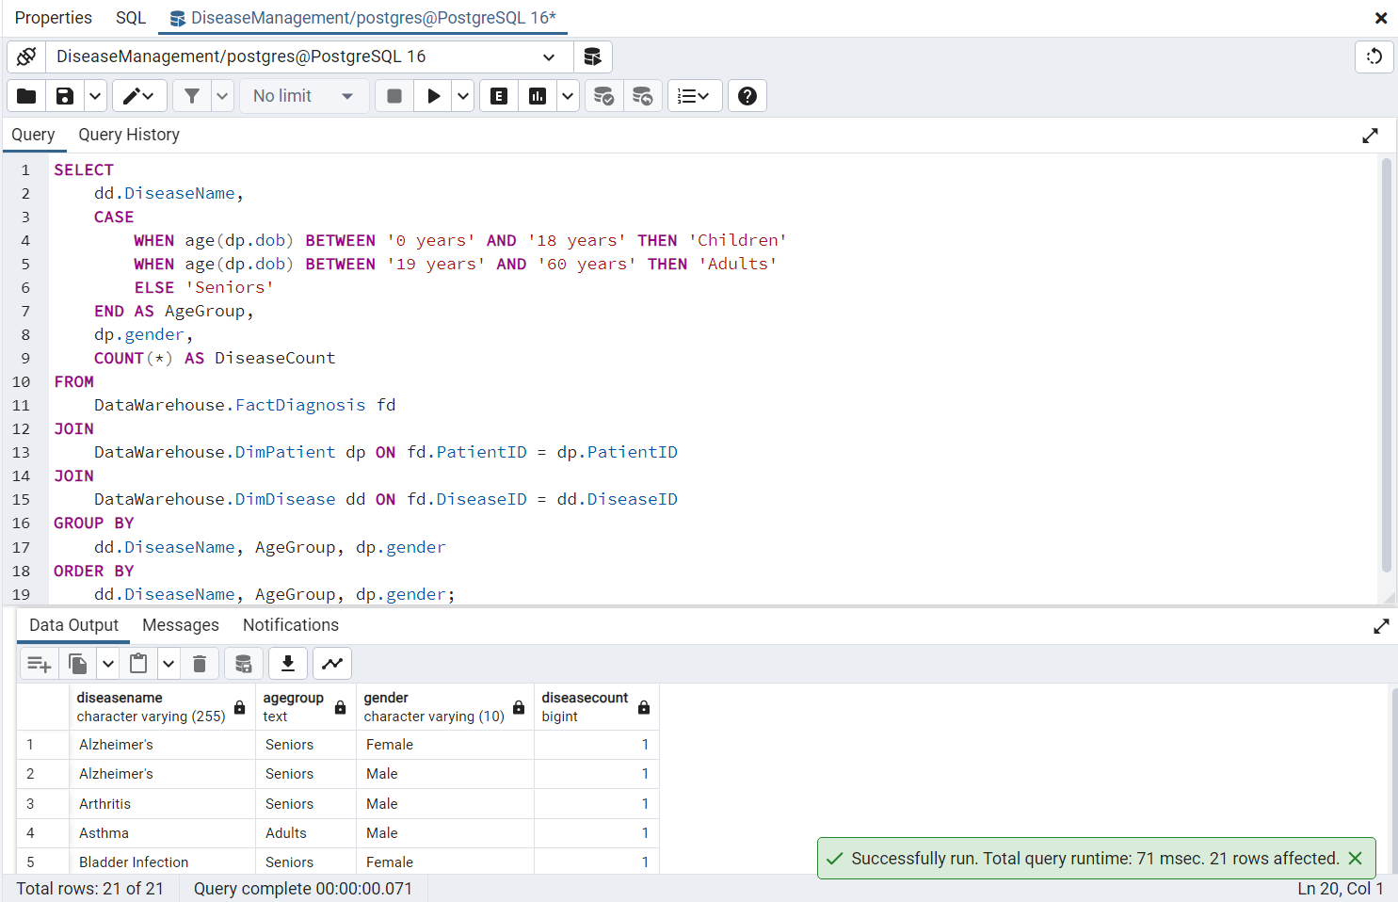
Analytical queries
1) Disease Incidence by Age Group and Gender :

Slide 22
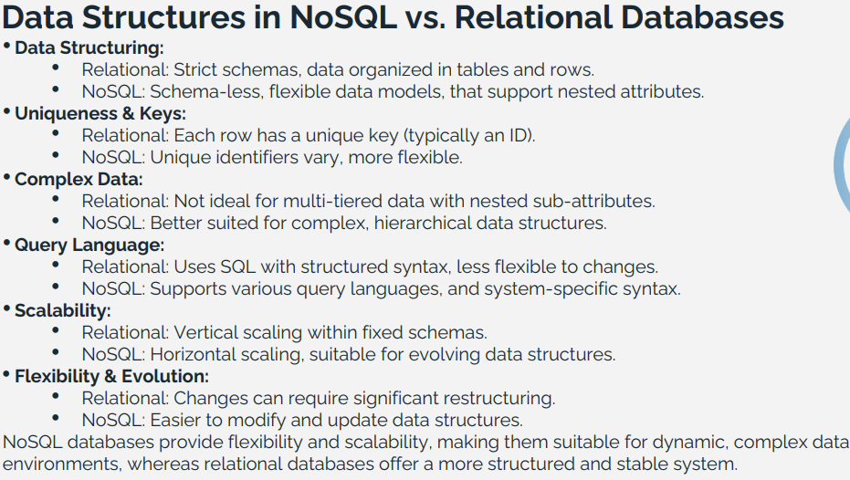
No SQL and Relational Contrast:

Slide 23
AWS Architecture for Data Processing:
Amazon S3 : This service is used to store all raw data. acts as the primary data lake where all incoming data whether it comes in streams or batches, is initially landed.
Amazon Kinesis : It is a service for managing real-time data streams. It instantly feeds real-time data into the processing systems by capturing it from multiple sources.
Amazon EMR : It provides Spark hosting for batch and real-time processing. EMR periodically executes jobs to process historical data stored in S3 for batch processing. It handles data arriving from Amazon Kinesis using Spark Streaming for real-time processing, processing it as it comes in.
Amazon Redshift : It serves as the serving layer, loading processed data from both batch and real-time processes. Large datasets can be queried complexly using this robust data warehouse, which integrates the output of both processing methods to provide thorough insights.
Amazon DynamoDB : Optionally used for storing outputs from real-time processing, enabling quick access to the most recent data.

Slide 24
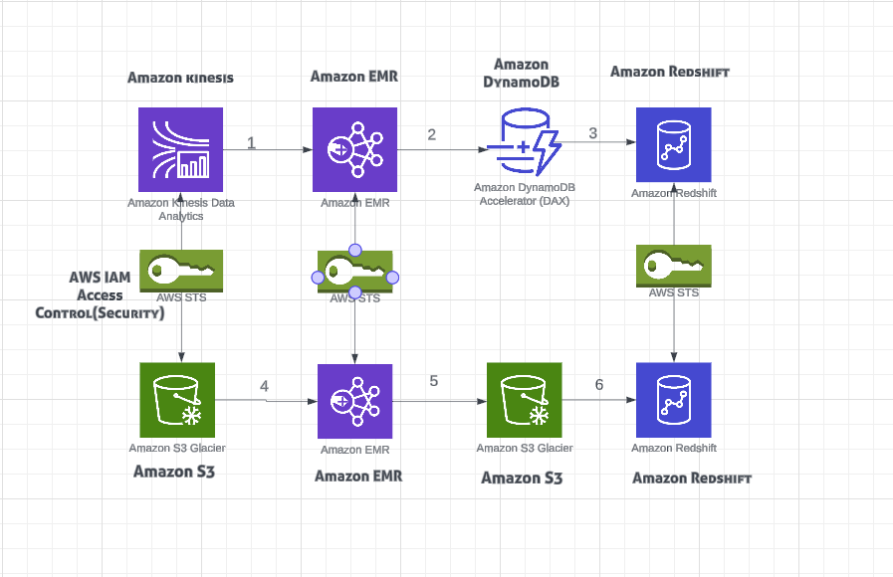
AWS- ARCHITECTURE DIAGRAM

Slide 25
Architecture - Explanation
Access Control/Security (Amazon IAM): Implements security guidelines for all system communications and data flows. It ensures that only authorized individuals and systems can access or utilize your AWS resources by managing permission and authentication for all involved AWS services.
(1)Amazon Kinesis to Amazon EMR: Real-time data is captured by Amazon Kinesis and sent to Amazon EMR for immediate processing.
(2)Amazon EMR to Amazon DynamoDB: Processed real-time data is stored in Amazon DynamoDB for quick access and retrieval.
(3)Amazon DynamoDB to Amazon Redshift: Data from DynamoDB is loaded into Amazon Redshift for integrated querying and analysis using Spark SQL.

Slide 26
Architecture - Explanation
(4)Amazon S3 to Amazon EMR: Raw batch data is taken from Amazon S3 and processed by Amazon EMR.
(5)Amazon EMR to Amazon S3: Processed batch data is stored back into Amazon S3 for persistence and further use.
(6)Amazon S3 to Amazon Redshift: Processed batch data from Amazon S3 is loaded into Amazon Redshift for comprehensive data analysis.
All the stages guarantee that data flows smoothly from storage to processing to ingestion, which in turn makes integrated analytics on Amazon Redshift.

Slide 27
Optimising DATA CAPABILITIES WITH SNOWFLAKE
How Snowflake enhances model:
Efficient Querying: Snowflake’s native support for simplifies data analysis by eliminating the need for significant preprocessing or transformation.
Scalability: Snowflake’s architecture allows for dynamic scaling of compute resources without interfering with ongoing processes.
Ease of Maintenance: Snowflake abstracts the complexity of infrastructure management, allowing data teams to focus more on data analytics.

Slide 28
Optimising DATA CAPABILITIES WITH SNOWFLAKE
Resource Optimization:
Snowflake’s streamlined management reduces the time data engineers spend on repetitive tasks, allowing them to focus on more strategic efforts.
Data Recovery and Reliability:
Snowflake provides automatic data replication and failover capabilities, protecting data from loss and ensuring business continuity.

Slide 29
THANK YOU

